Slide 1
APM Introduction

Slide 2



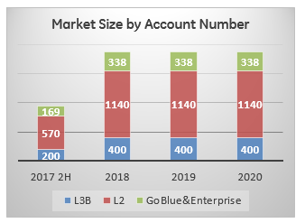







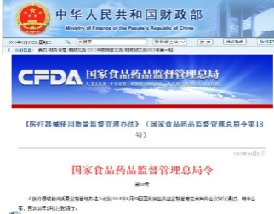
APM Market Overview
Competition
-OEM(5%)+3RD PARTY(15%)+SIs(80%)
-more than 20 local brands (SIs)
-Local vendors price<30K USD
Increasing Investment in Healthcare IT systems along with the amount of healthcare asset rapidly expanding
Investment
Competition
APM
(CMMS)
Growing customers’ need in more advanced method to manage Asset
- 73% of hospitals can not cover the whole life cycle management
-90% of the hospitals would like to use CMMS
(Survey conducted by PLDP team in 2015)
Regulation and Polices (18#) suggest the use of CMMS-CFDA
Regulation
Customer
Notes:
For Market Size:
-L3B Hospital number: 2000; L2 Hospital number: 7600; Goblue&Enterprise: 3375 (total12000~15000,cover 25%)
-20% of L3B,15% of L2 and 10% of GoBlue&Enterprise will purchase CMMS
-2017’s estimate is half year since start from 2H

Slide 3
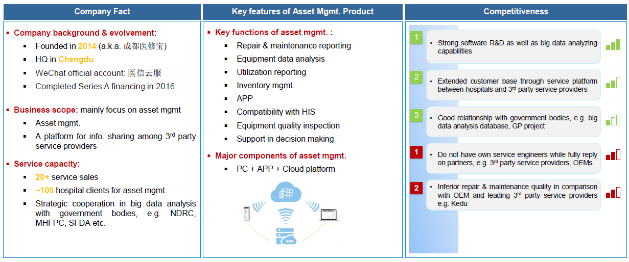
Major Competitor (医信云服)

Slide 4
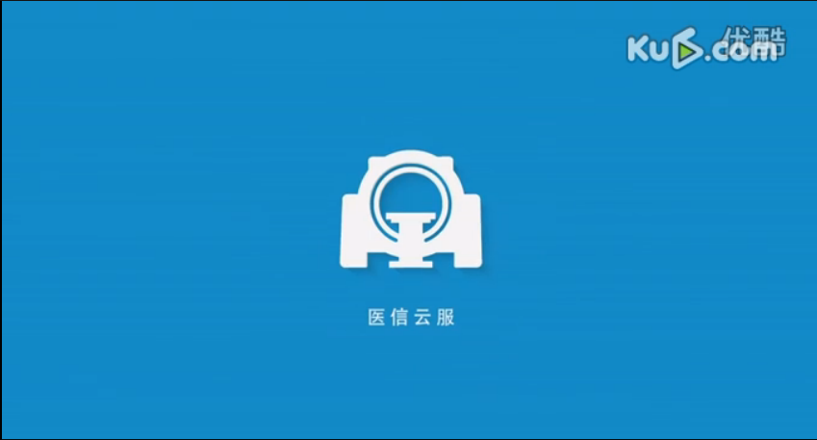
Major Competitor (医信云服) - Video

Slide 5
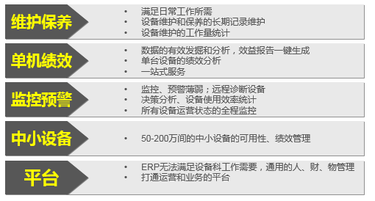
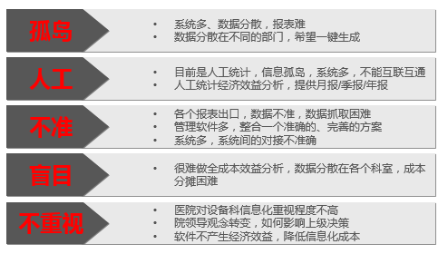
Why APM?
Needs
价格
云的安全性
多厂商的支持
全院设备类型的支持
Lock-in
Fears
Pains

Slide 6
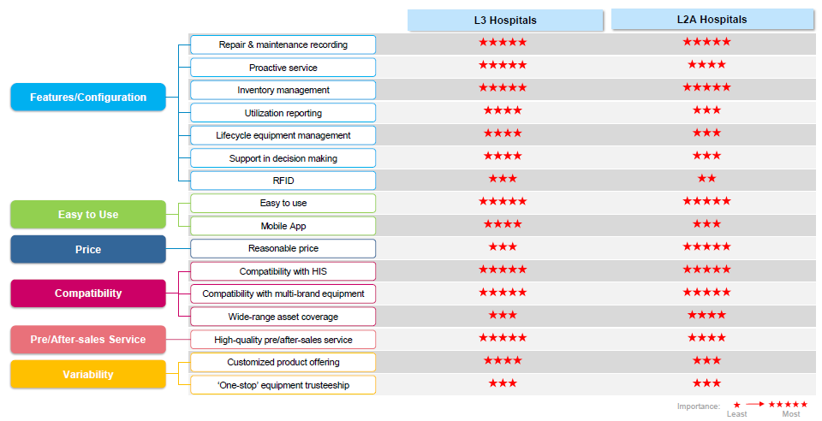
Why APM? – minimum requirements

Slide 7
Customer Segmentation
Means ratio of hospitals having IH or ODS.
Data to be verified
 | EAM | DI |  |  | Biomed |  |  | RIS/HIS | FIN
 |  | DI Full Service | DI ODS | DI# | Biomed Full Service | Biomed ODS | Biomed#
L3A | 80% | 89% | 20% | 50+ | 67.9% | 100% | 1000+ | 100% | + | Advanced
L3B | 30% | 44% | 50% | 40+ | 52% | 100% | 800+ | 100% | + | Standard/ Advanced
L2 | 10% | 16% | 80% | 20+ | 30.4% | 100% | 500+ | 100% | + | Standard
Enterprise | 0 | 50% | 50% | 10+ | 39% | 100% | 300+ | 100% | + | Standard/ Advanced
Imaging Center | 0 | 70% | 30% | 30+ | 10% | 100% | 50+ | 100% | + | Standard/ Advanced
Private | 10% | 8% | 80% | 5+ | 0.4% | 100% | 50+ | 100% | + | Standard
PCB | 0 | 4% | 95% | 0-1 | 0.2% | 100% | 10+ | ? | - | TBD
Opportunist (~7000)

Slide 8



Value Proposition
CXO
BME
Clinic
Investment optimization
Reduce operation cost
Cost
Compliance with CFDA18
Reduce Down time
Improve efficiency
Quality
Easy to get asset reports
Data security and privacy
Collaboration anytime
Access
degree

Slide 9
Target Customer
Academic
(~100)
L3
(~2000)
Priority 1
Priority 2
(~7000)
Priority 3
L2
Enterprise & Private
(~13000)
L1/0
(~60K)

Slide 10
What’s APM?
Operational
Utilization (IPM)
Utilization (RIS)
Financial
Repair
PM
Predict
KM
Remote fix
Predict
Cold head
EE
Global Features
Differentiatons
CMMS
GE
Parts
Data watch
MVS
GE
KM
Foundation
Location Tracking

Slide 11
Offering
Outcome
GE Impact
Standard
Mitigate risk
  Comply with regulation (CFDA 18)
Reduce cost
  Maximize utilization
  Improve maintenance efficiency (*Avg. fix time reduce 30%)
Increase ROI
Optimize investment (*saving 10%)
Improve Experience
Reduce waiting time
Minimize unplanned down-time
Capture rate
  Renewal
  Convert
  Win-back
Incremental revenue
Reduce price erosion
Protect socket
New service model
  MVS/MES
Predictive
CMMS
Advanced
Analytics
(mid-range)
Analytics
(FIN+Clinic) for DI
Predictive
CMMS

Slide 12
Feature Development Plan
CY17 Q4
-Q1’18
Location Tracking
Global APM
CY17 Q3
Data Watch MVS
Analytics
(mid-range EQT Utilization)
Analytics
(mid-range EQT Utilization)
CY17 Q2
GE Knowledge Mgt
Analytics
(FIN+Clinic) for DI
Analytics
(FIN+Clinic) for DI
Analytics
(FIN+Clinic) for DI
GE Parts
Predictive
Predictive
Predictive
CMMS
(Mobility)
CMMS
(Mobility)
CMMS
(Mobility)
China solution
Global solution

Slide 13
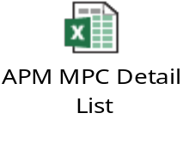
Commercial Activation
Focus on North&East regions
around Beijing and Shanghai to achieve 50 sites firstly
高定版
Bundle with MES
量身定制
满足个性化需求
Prefer In House and MVS
500 in FY17
MPC briefing:
 | North | East | South | West | China
Direct | 25 | 20 | 13 | 15 | 73
Indirect | 12 | 15 | 7 | 5 | 39
In total | 37 | 35 | 20 | 20 | 112
North
Direct MPC
East
West
Indirect MPC
South

Slide 14
APM Demo

Slide 15
Appendix

Slide 16
APM Function View
Reports
& Analysis
Global Optional
Repair
PM
Predict
KM
GE Service Manual
Nov
GE
PSDB
GE
PM Checklist
GE Parts Search
Dec
GE Service Call reports
Location Tracking
Nov
Foundation

